Slide 1
Loss Distributions
HSBC Quant Academy
Prepared by: Jorge Rosales
Date: March 2026

Slide 2
Contents
1. Financial Risks Review | 03
2. Modelling Uncertainty | 04
3. Credit Risk Modelling | 05
4. Other Loss Distributions | 10
5. Risk Metrics | 12

Slide 3
1. Financial Risks Review

Slide 4
Financial Risk Types
Credit risk
Market risk
Liquidity risk
Operational risk
Legal
Technological

Slide 5
Non Financial Risk Types
Strategic risk
Business risk
Reputational risk

Slide 6
Credit Risk
Counterparty Credit Risk
Repos
Derivatives
Portfolio Credit Risk
Commercial, Mortgage or Retail
Credit letters
Issuer Credit Risk
Corporate Bonds
Foreign Sovereign Bonds

Slide 7
Market Risk
Fixed income securities
Bonds
Interest rate derivatives
Prices
Stocks, commodities
Stock derivatives
FX rates
Currencies
Currency derivatives

Slide 8
Liquidity Risk
Bid-ask spreads
Marketable securities
Asset-liability gap
Liquidity Coverage Ratio
Net Stable Funding Ratio

Slide 9
Operational Risk (Basel Committee, 2005)
Business disruptions and systems failure
Clients, products, and business practices
Damage to physical assets
Employee practices and workplace safety
Execution, delivery and process management
Internal Fraud
External Fraud

Slide 10
Risk Management? (Jorion, 2006)
Barings
Orange county
LTCM
ENRON
Credit –subprime- crisis
LIBOR manipulation
Silicon Valley Bank
...

Slide 11
Historical Evolution of Risk Management
Gambling
Insurance
Portfolio optimization
Banking
Asset management

Slide 12
Risk Management Process
Identify
Measure
Control

Slide 13
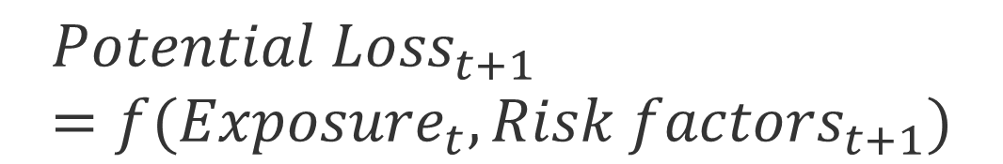
Risk Measurement
$${Potential Loss}_{t+1}=f({Exposure}_{t}, {Risk factors}_{t+1})$$

Slide 14
Risk Exposure?
Does a fixed rate sovereign bond has credit risk?
Does a bond held to maturity have market risk?
Does a AAA bond portfolio funded by deposits have liquidity risk?

Slide 15
Uncertainty, risk and metrics
Uncertainty
Volatility
Standard deviation
Value at Risk
Unexpected loss (Bluhm, et al, 2002)
Expected shortfall (Artzner, et al, 1999)

Slide 16
Uncertainty
We conduct 10 independent flips of a coin. On the first 9 it lands "heads"
What is the probability that on the tenth throw "heads" will fall?

Slide 17
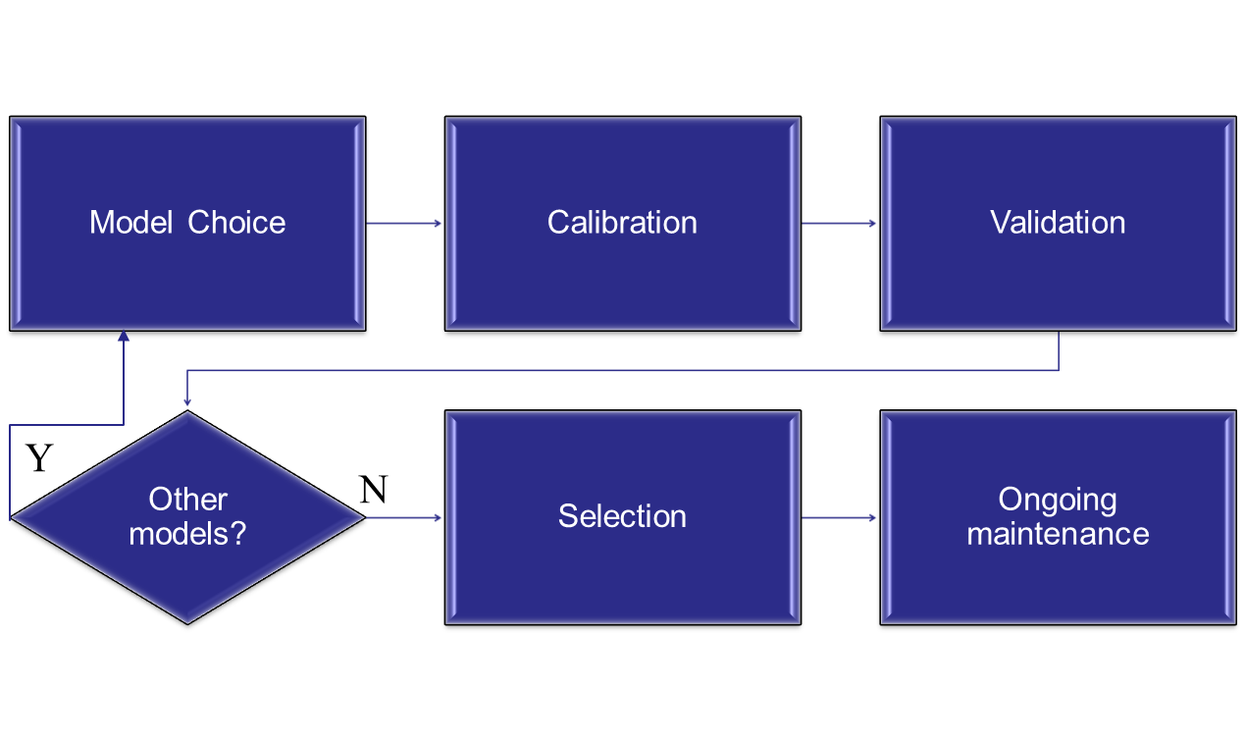
Modelling Process

Slide 18
Modelling the –uncertainty of– the market (Meucci, 2009)
Detect the invariants: risk factors that can be regarded as iid random variables.
Determine the distribution of the invariants: non-parametric, maximum likelihood, shrinkage, robust estimators.
Project the invariants to investment horizon: linear, monotonic, non-linear.
From invariants to security prices: full revaluation, key risk sensitivities, Taylor expansion.

Slide 19
Model risk
Detect the invariants: Model specification risk.
Determine the distribution of the invariants: estimation risk.
Project the invariants to investment horizon: propagation risk.
From invariants to security prices: approximation risk.

Slide 20
2. Modelling Uncertainty

Slide 21
Modelling Uncertainty
Random experiment: flip a coin and record the result ("heads" or "tails") .
We need a mathematical model that represents reality and include:
Set of possible outcomes
Collection of events of interest
Probability of each outcome

Slide 22
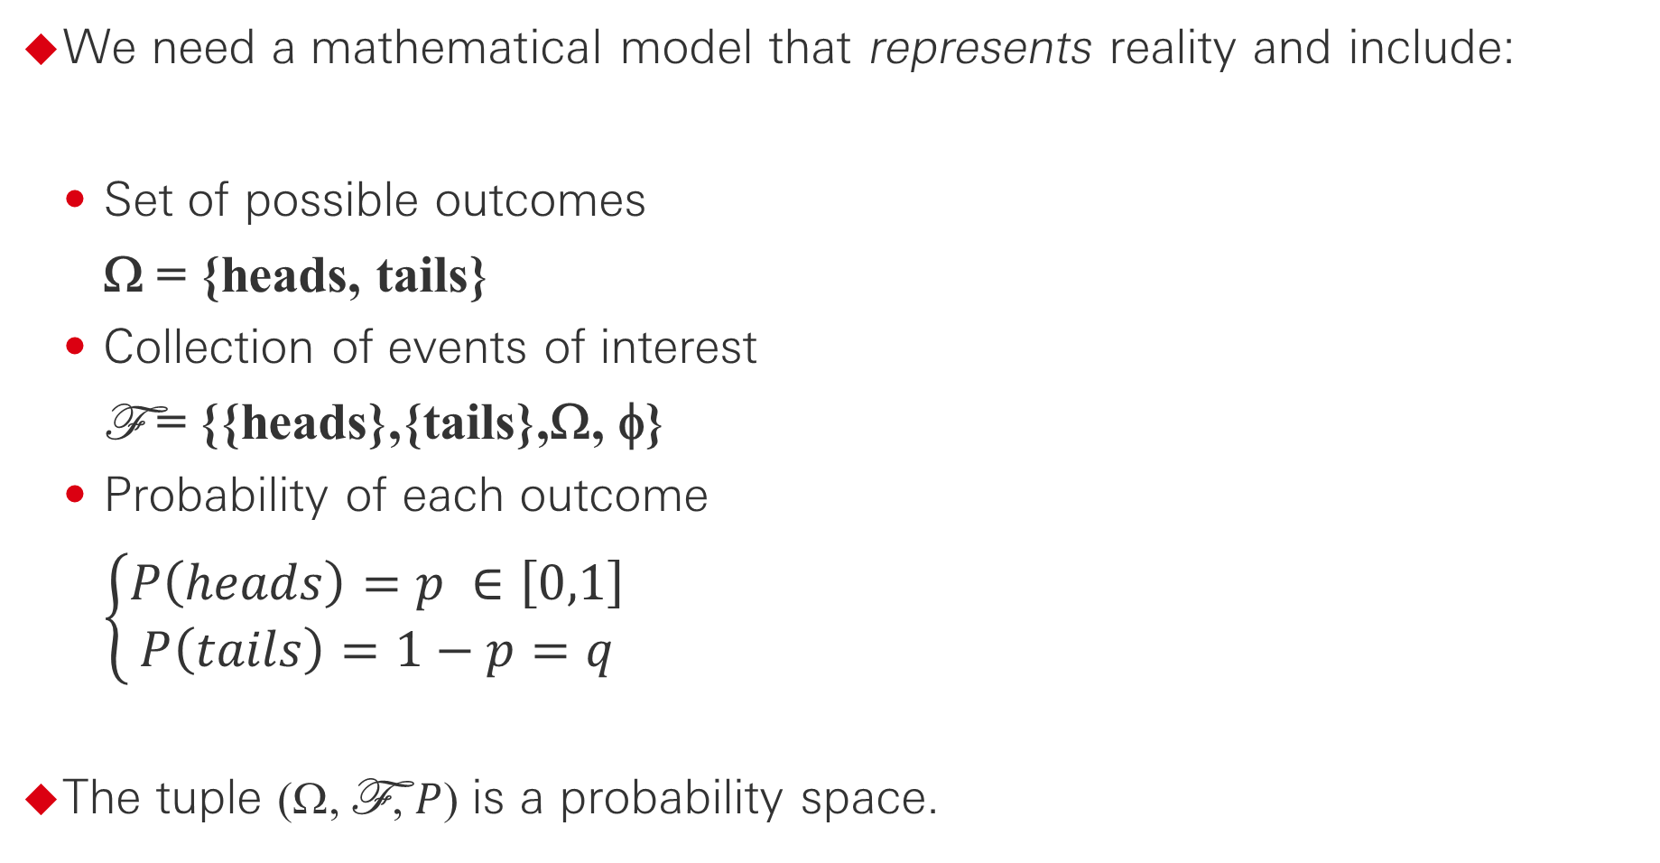
Modelling Uncertainty
We need a mathematical model that represents reality and include:
Set of possible outcomes
Ω = {heads, tails}
Collection of events of interest
F = {{heads},{tails},Ω, φ}
Probability of each outcome
$$\left\{\begin{aligned}P\left(heads\right)=p ∈\left[0,1\right] \\ P\left(tails\right)=1−p=q\end{aligned}\right.$$
The tuple (Ω, F , $P$) is a probability space.

Slide 23
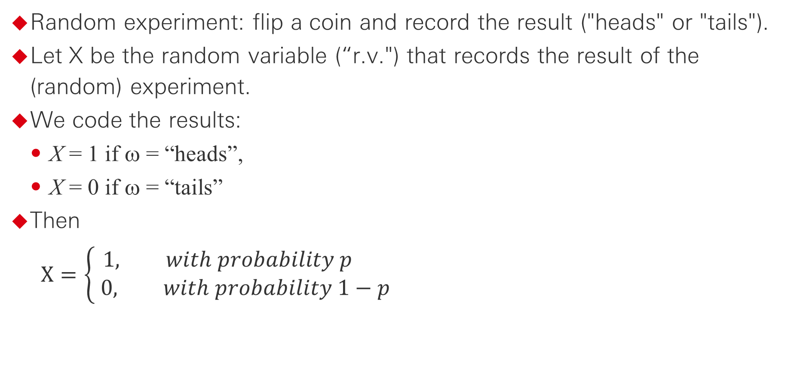
Modelling Uncertainty
Random experiment: flip a coin and record the result ("heads" or "tails").
Let X be the random variable (“r.v.") that records the result of the (random) experiment.
We code the results:
X = 1 if ω = “heads”,
X = 0 if ω = “tails”
Then
$$X=\left\{\begin{aligned}1, with probability p \\ 0, with probability 1−p\end{aligned}\right.$$

Slide 24
Modelling Uncertainty
We say that X is distributed Bernoulli with parameter p and write X ~ Ber(p).
In addition:
E(X) = p,
Var(X) = p * (1-p)

Slide 25
Modelling Uncertainty
Random experiment: flip a coin n times and record the number of times it comes up "heads".
Let Y be the r.v. that records the result of the experiment.
What are the possible values for Y? How likely is each of them?
Let n=3, p=½ and find (Ω, F , P) and the distribution of Y.

Slide 26
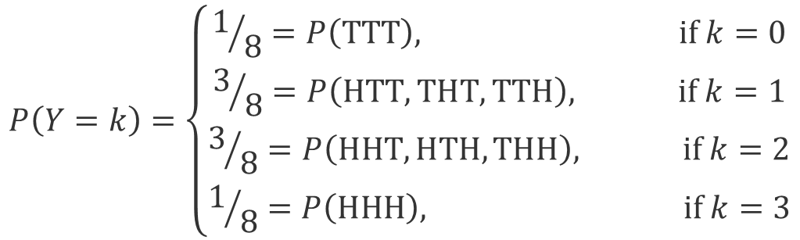
Modelling Uncertainty
Ω
F
φ,
{HHH}, {HHH}^{C}, …,
{HHH,THH}, {HHH,THH}^{C},…,
{HHH,THH,HHT},… {HHH,THH,HHT} ^{C}, …,
…,
Ω.
HHH THH
HHT THT
HTH TTH
HTT TTT
$$P\left(Y=k\right)=\left\{\begin{aligned}1/8=P\left(TTT\right), if k=0 \\ 3/8=P\left(HTT,THT,TTH\right), if k=1 \\ 3/8=P\left(HHT,HTH,THH\right), if k=2 \\ 1/8=P\left(HHH\right), if k=3\end{aligned}\right.$$

Slide 27
Modelling Uncertainty
In general,
We say that Y follows a Binomial distribution with parameters n and p denoted as Y ~ Bin(n,p).
Additionally:
E(Y) = n * p,
Var(Y) = n * p * (1-p)

Slide 28
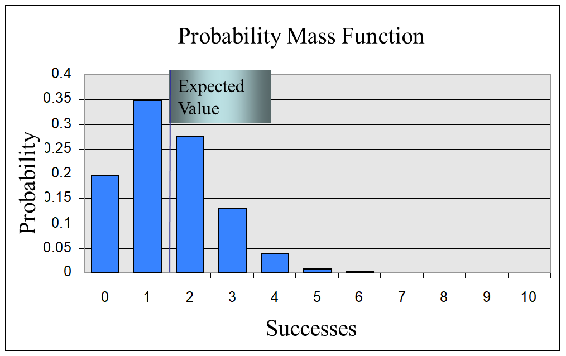
Modelling Uncertainty

Slide 29
Modelling Uncertainty
Random experiment: flip a coin n times and record the number of times it comes up "heads".
Let Y be the rv that records the result of the experiment. We know that Y follows Bin(n, p).
However, if n is large enough, what is the distribution of Y?
By the Central Limit Theorem, Y → W ~ N(μ = np, σ² = np(1-p)) as n → ∞.

Slide 30
Modelling Uncertainty
Probability Mass/Density Function
Expected value
n = 50
p = 0.15
Probability
Successes

Slide 31
3. Credit Risk Modelling

Slide 32
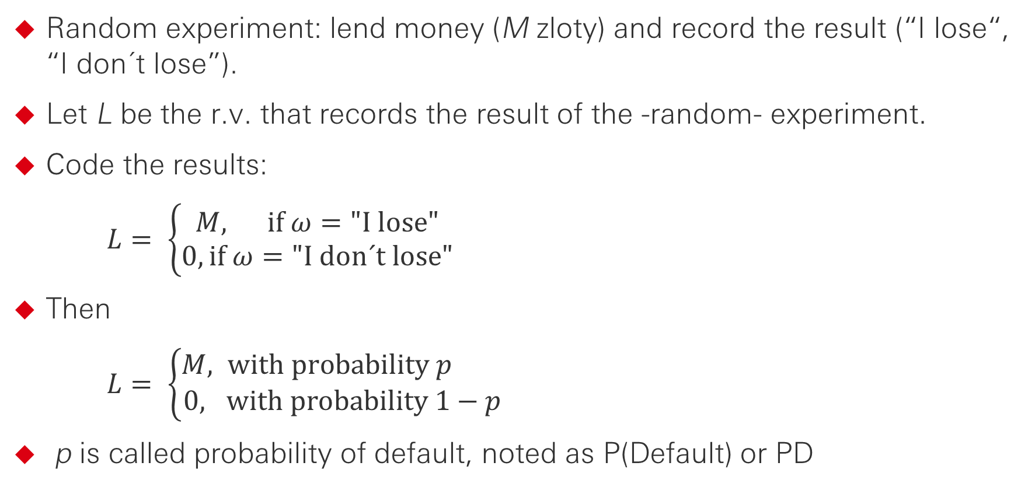
Loss Distribution for a Credit
Random experiment: lend money (M zloty) and record the result (“I lose“, “I don´t lose”).
Let L be the r.v. that records the result of the -random- experiment.
Code the results:
$L= \left\{\begin{aligned}M, if ω="I lose" \\ 0, if ω="I don´t lose"\end{aligned}\right.$
Then
$L= \left\{\begin{aligned}M, with probability p \\ 0, with probability 1−p\end{aligned}\right.$
p is called probability of default, noted as P(Default) or PD

Slide 33
Loss Distribution for a Credit
L has a (mass) probability function:
L has –cumulative– distribution function:
Probability Mass Function
Cumulative Probability Distribution Function
Additionally
E(L) = M * p = Exposure * P(Default),
Var(L) = M² * p * (1-p).
StdDev (L) = M * √(p * (1-p))

Slide 34
Loss Distribution for a Portfolio
Consider a portfolio of n credits with equal maturity.
Let Mj be the exposure of the jth credit.
Let Lj be the loss of the jth credit.
Let Dj be the default indicator of the jth credit.
Let L be the aggregated portfolio loss.
Then

Slide 35
Loss Distribution for a Portfolio
If Mj = M for each j, the distribution of L is known (what is it?).
But… if the credit exposure is not constant, the distribution of L is not straightforward.
However:
What about other metrics?

Slide 36
Loss Distribution for a Portfolio
If the creditors are independent:
What if they are not independent?
What about quantiles?

Slide 37
Other Risk Factors
Mj is the exposure of the jth credit.
However:
Current exposure is not relevant, but that one at the moment of default (EAD).
If the creditor defaults, it is generally possible to recover something.
Let RR (=1-LGD) be the recovery rate (opposite of loss given default).
RR is a r.v. on [0, 1]
What is its distribution?

Slide 38
4. Other Loss Distributions

Slide 39
Other Risk Factors (Klugman, et al, 2012)
Risk = Frequency „*” Severity
Random

Slide 40
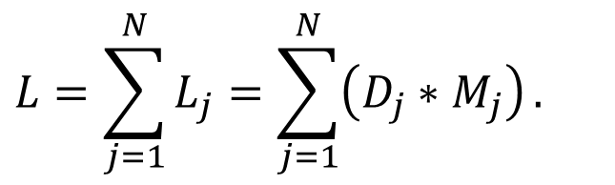
Compund Loss Distribution
$$L=\sum_{j=1}^{N}{L_{j}}=\sum_{j=1}^{N}{\left(D_{j}∗M_{j}\right)}.$$
N is the frequency of losses, and follows a counting distribution.
L_{j} is the individual jth severity loss, and follows a continous distribution.
L is the total loss, and follows a compund distribution.
Notes:
Exponga las acciones que recomienda. Describa el proceso de forma específica, clara y breve. Compruebe que es capaz de imaginarse a la audiencia emprendiendo la acción propuesta; si usted no puede hacerlo, ellos tampoco. Exponga el plan de acción con firmeza y tendrá más posibilidades de motivar a la audiencia para que lo adopte.

Slide 41
Compund Loss Distribution
Frequency (N)
Severity (LGD)
Loss (L)
Notes:
Exponga las acciones que recomienda. Describa el proceso de forma específica, clara y breve. Compruebe que es capaz de imaginarse a la audiencia emprendiendo la acción propuesta; si usted no puede hacerlo, ellos tampoco. Exponga el plan de acción con firmeza y tendrá más posibilidades de motivar a la audiencia para que lo adopte.

Slide 42
5. Risk Metrics

Slide 43
Risk Metrics Based on Loss Distributions
Expected Loss:
E(L).
Value at Risk:
VaR_{α} = q, such that P(L>q) ≤ α.
Unexpected loss (at level α):
VaR_{α} – E(L).
Expected shortfall (conditional VaR, tail VaR):
ES_{α} = E(L|L > VaR_{α}).

Slide 44
Risk Metrics Based on Loss Distributions
Probability
Expected Loss (EL)
Consider lending 100 zloty to a friend with a 10% chance of default, and zero rate of recovery (i.e. 100% LGD).
The expected loss is then 10 zloty.
Actually, you will get back the full weight or nothing.
For large, pulverized portfolios, the actual loss of the portfolio is going to converge, in the long run, to the EL.
Unexpected Loss (UL)
In any given period, however, much more could be lost, as the distribution of credit losses is long-tail.
How much capital do I need to deal with unexpected losses with a 99% confidence level?
The answer is the UL.
It aims for a 1% probability of insolvency in the event of impairment.
Media
Percentile 99
EL
UL
Portfolio Aggregated Loss ($)
Regulatory Capital Basel I
Basel II, provisions & write-offs
Regulatory Capital Basel II

Slide 45
Value at Risk (VaR)
Expected Loss
Unexpected Loss(es)
Catastrophic Loss
Probability
Loss (L)
VaR_{α}
Price | Capital and Reserves | Capital
Price | Capital and Reserves | Insurance

Slide 46
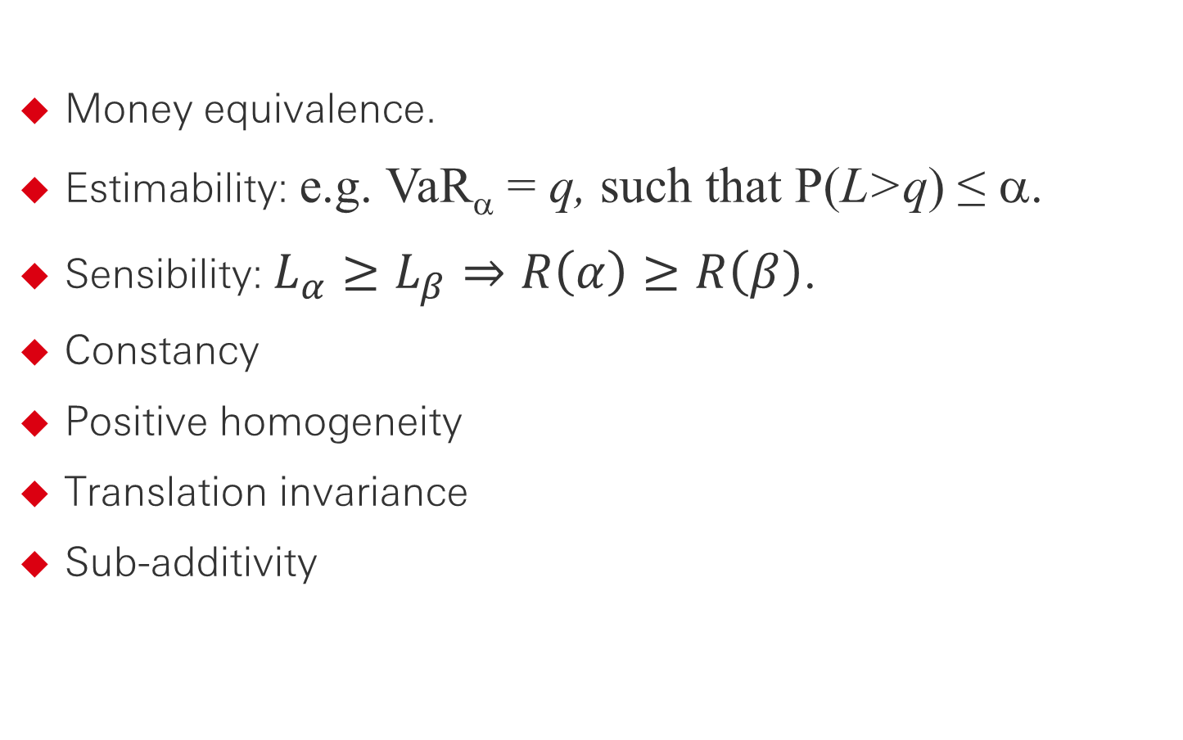
Properties of Risk Metrics
Money equivalence.
Estimability: e.g. VaR_{α} = q, such that P(L>q) ≤ α.
Sensibility: $L_{α}≥L_{β}⇒R\left(α\right)≥R\left(β\right)$.
Constancy
Positive homogeneity
Translation invariance
Sub-additivity

Slide 47
Properties of Risk Metrics
Moments
Quantiles
Coherent indices
Spectral measures

Slide 48
Concluding remarks
Risk is a measure of potential –future– loss.
We model uncertainty.
All models are wrong, but some are more useful than others.
The real challenge is to detect evolving risks and quantify them.

Slide 49
References
Artzner P.F. et al (1999) Coherent measures of risk. Mathematical Finance 9, 203-228
Basel Committee (1988, 2005, 2018). www.bis.org
Bluhm, C., et al (2002) An Introduction to Credit Risk Modelling. Chapman and Hall.
Jorion, P. (2006) Value at Risk, 3rd ed. McGraw Hill.
Klugman, S.A., H. Panjer & G. Wilmot (2012) Loss Models, 4th ed. Wiley.
Meucci, A (2009) Risk and Asset Allocation. Springer.
Shreve, S.E. (2004) Stochastic Calculus for Finance I. Springer.

Slide 50
Disclaimer
This presentation has been prepared by HSBC Service Delivery (Polska) Sp. z o.o. with a registered office located at Kapelanka 42A, 30-347 Kraków, Poland, registered in the District Court for Kraków-Śródmieście in Kraków, XI Commercial Division of the National Court Register, under the number KRS 0000310459, share capital (entirely paid) in the amount of 67 689 500,00 PLN, NIP 525-242-91-07, hereinafter referred to as “HSBC”.
HSBC has based this document on information obtained from sources it believes to be reliable but which has not been independently verified. While this information has been prepared in good faith, no representation or warranty, express or implied, is or will be made and no responsibility or liability is or will be accepted by the HSBC, or by any of their respective officers, employees or agents in relation to the accuracy or completeness of the Documents or any other written or oral information made available to any interested party or its advisers and any such liability is expressly disclaimed. Any charts and graphs included are from publicly available sources or proprietary data. No liability is accepted whatsoever for any direct, indirect or consequential loss arising from the use of this document. HSBC is under no obligation to keep current the information in this document. You are solely responsible for making your own independent appraisal of and investigations into the data, products, financial instruments and transactions referred to in this document and you should not rely on any information in this document as constituting investment advice. Neither HSBC nor any of its affiliates are responsible for providing you with legal, tax or other specialist advice and you should make your own arrangements in respect of this accordingly. The issuance of and details contained in this document, which is not for public circulation, does not constitute an offer or solicitation for, or advice that you should enter into, the purchase or sale of any security, commodity or other financial instrument or master agreement, or any other contract, agreement or structure whatsoever. This document is intended to be distributed in its entirety. Reproduction of this document, in whole or in part, or disclosure of any of its contents, without prior consent of HSBC or any associate, is prohibited.

Slide 51
Thank you

